Slide 1
RESTful Web Services with Java
Notes:
Add instructor notes here.

Slide 2

Lesson Contents
Introduction to Webservice
REST as Lightweight Web Services
REST Architecture Components

Slide 3
Network-based Application Architectures
Network-Based Systems
Capable of operation across a network, but not necessarily in a fashion that is transparent to the user
Distributed System
For users like an ordinary centralized system,
But actually runs on multiple, independent CPUs

Slide 4
Web Services
A Web Service is a software application identified by a URI, whose interfaces and binding are capable of being defined, described and discovered by XML artifacts and supports direct interactions with other software applications using XML based messages via Internet-based protocols.

Slide 5
Web Services
Web Service is a Web resource that has been designed for programmable access. It allows other applications to access and use it in a well-defined manner
Web services are software components that make resources available on the Internet.
The resource can be any type of data
Simple text
HTML
XML
Image
Raw data etc.
Applications can retrieve, parse and use this data for processing or for presentation

Slide 6
REST - REpresentational State Transfer.
REST is an architectural style.
REST approach is one of the major resource-oriented approach to building distributed systems
REST describes any simple interface that transmits data over a HTTP without an additional messaging layer, such as SOAP.
REST provides a set of design rules for creating stateless services that are viewed as resources, or sources of specific information, and can be identified by their unique URIs.
A client accesses the resource using the URI, a standardized fixed set of methods, and a representation of the resource is returned.
The client is said to transfer state with each new resource representation.

Slide 7
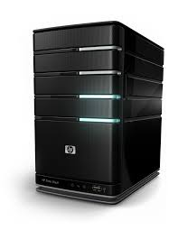

Why is it called REST ?
The Client references a Web resource using a URL
A representation of the resource is returned
The representation places the client application in a state.
The result of the client traversing a hyperlink in is another resource is accessed.
The new representation places the client application into yet another state.
Thus, the client application changes (transfers) state with each resource representation => Representation State Transfer
http://www.igate.com/empList.html
Emp 1
Emp 2

Slide 8
Resource Oriented Architectures ( ROA)
Components of ROA
Resources
Name of Resources (URIs)
Resources Representations
The links between Resources
Properties
Addressability - URLs as identifiers
Statelessness
Connected - - Logically-connected, Late-binding Systems
A uniform interface
Notes:
Architecture refers to the overall structure of an information system and the interrelationships of entities that make up that system.
Web application should be designed following these concepts and properties.
A resource is anything that can be identified by a URI. In the first step of the previous flow, the URI typed by the user is the address of a resource that corresponds to a web page. In a typical static website, every web page is a resource.
A representation is an encapsulation of the information (state, data, or markup) of the resource, encoded using a format such as XML, JSON, or HTML.
Use of a uniform interface makes the request and responses self-describing and visible. In addition to GET and POST methods, this interface consists of other methods such as OPTIONS, HEAD, PUT, DELETE, TRACE, and CONNECT.
Each representation that the client receives from the server represents the state of the user’s interaction within the application. For instance, when the user submits the form to receive another page, the user changes the state of the application from her point of view
Addressability is the idea that every object and resource in your system is reachable through a unique identifier.
stateless means that there is no client session data stored on the server. The server only records and manages the state of the resources it exposes. If there needs to be session-specific data, it should be held and maintained by the client and transferred to the server with each request as needed
All URIs should be designed for clarity and consistency. The representations (HTML and XML) should be well formed and structured.
All representations should be strongly linked. It should always be possible to navigate through the representation of all entities just by following links

Slide 9
Resource Oriented Architectures ( ROA)
Every resource on the network can located via a globally unique address known as a Universal Resource Identifier or URI
Involve retrieving particular resource instances
Retrieving a HTML page using HTTP GET request
Retrieving a database table row using a SQL SELECT command
Usually have operations for resource lifecycle management
Resources are manipulated by HTTP verbs (GET, PUT, POST, DELETE)
Requests are usually stateless
No link between one request and the next
Client manages any concept of “conversation state”
Manipulation of network resources is performed solely by components on the network (essentially browsers and other Web servers).

Slide 10
REST: Noun (Resource) Oriented
About resources
The operations are standard via HTTP
Resources can be cached, bookmarked, saved via standard mechanisms
Customer
http://example.com/customer/123
http://example.com/order/555/customer
{POST, GET, DELETE}

Slide 11
REST Architectural Elements
Data:
Resource The intended conceptual target resource
Identifier URL, URN
Representation HTML document, JPEG image
Representation metadata media type, last-modified time
Resource metadata source link, alternates, vary
Connectors:
Client libwww, libwww-perl
Server libwww, Apache API, NSAPI
Cache browser cache, Akamai cache network
Resolver bind (DNS lookup library)
Components:
Origin server Apache httpd, Microsoft IIS
Gateway Squid, CGI, Reverse Proxy
Proxy CERN Proxy, Netscape Proxy, Gauntlet
User Agent Netscape Navigator, Lynx, MOMspider
Notes:
Explain the participants not to carry the analogy too far: unlike letters-vs.-postcards, REST is every bit as secure as SOAP. In particular, REST can be carried over secure sockets (using the HTTPS protocol), and content can be encrypted using any mechanism you see fit. Without encryption, REST and SOAP are both insecure; with proper encryption in place, both are equally secure.

Slide 12
REST Architectural Style
Data and functionality are considered resources,
Resources are accessed using Uniform Resource Identifiers (URIs)
The resources are acted upon by using a set of simple, well-defined operations.
The REST architectural style constraints an architecture to a client-server architecture
Designed to use a stateless communication protocol, typically HTTP.
In the REST architecture style, clients and servers exchange representations of resources using a standardized interface and protocol.
These principles encourages RESTful applications to be simple, lightweight, and have high performance.

Slide 13
RESTful Web Service Design Principles
Four basic design principles:
Use HTTP methods explicitly.
Be stateless.
Expose directory structure-like URIs.
Transfer XML, JavaScript Object Notation (JSON), or both.

Slide 14
Use HTTP methods explicitly
REST design principle establishes a one-to-one mapping between create, read, update, and delete (CRUD) operations and HTTP methods.
According to this mapping:
To create a resource on the server, use POST.
To retrieve a resource, use GET.
To change the state of a resource or to update it, use PUT.
To remove or delete a resource, use DELETE.

Slide 15
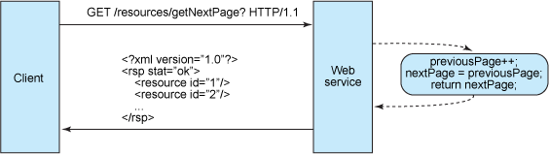
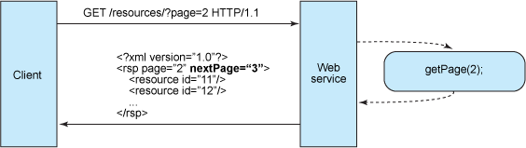
Stateless
Stateful
Stateless

Slide 16
Stateless
Stateless means that there is no client session data stored on the server.
The server only records and manages the state of the resources it exposes.
If there needs to be session-specific data, it should be held and maintained by the client and transferred to the server with each request as needed.

Slide 17

Lesson Summary
We have so far seen:
Introduction to Webservice
REST as Lightweight Web Services
REST Architecture Components

